Slide 1
University American College Skopje
Course: Business Computer Applications
Getting the most from Excel – level II
Marija Stanojeska, PhD

Slide 2

Based on the textbook:
Microsoft Office Inside Out (Office 2021 and Microsoft 365), J. Habraken, Pearson Education, Inc., 2022.

Slide 3
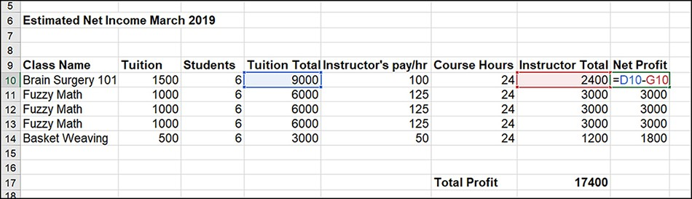
Performing calculations in Excel worksheets
Excel provides you with two diﬀerent ways to do calculation in your worksheets: formulas and functions. Formulas are do-it- yourself math. You specify the cells to be referenced in the calculation, and you also provide the operators, which determine what kinds of calculations actually take place.
Formulas are best reserved for simple calculations, such as subtraction, multiplication, and division. You can show the formulas and/or functions in a sheet by selecting the Show Formulas command. The command is found in the Formula Auditing group on the ribbon’s Formulas tab.
A subtraction formula that subtracts the payment to the instructor (G10) from the Tuition Total for that class (D10).

Slide 4
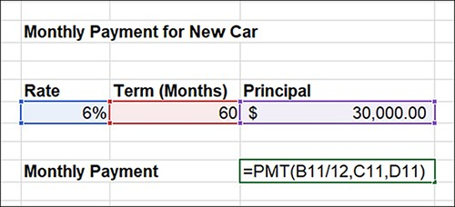
Performing calculations in Excel worksheets (cont.)
Functions, on the other hand, are built-in formulas provided by Excel. The Excel Function Library is huge; it provides nearly 500 functions, grouped into categories that include date and time functions, engineering functions, ﬁnancial functions, math and trigonometry functions, statistical functions, and even text functions. Figure shows the PMT function, which is an Excel function used to determine the periodic payment on a loan that has a ﬁxed interest rate.

Slide 5
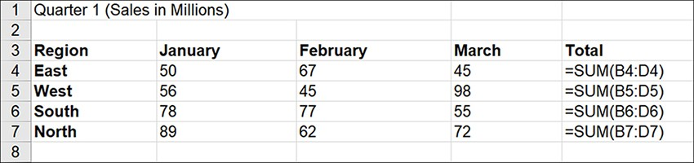
Relative referencing
When you create a formula or function and designate cell references, Excel uses a form of referencing called relative referencing. When you copy a formula or a function from one cell to another cell, the cell references in the formula or function are rewritten to adjust to its new location.

Slide 6
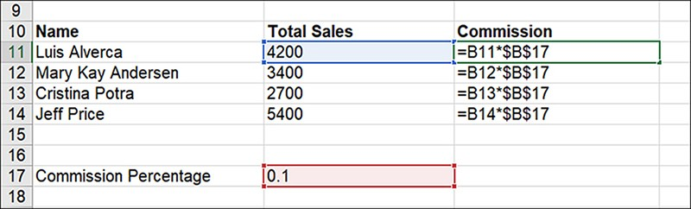
Absolute referencing
In some situations, you need to override Excel’s relative referencing so that a formula or function does not change all the cell references when you copy it to a new location. This is where absolute referencing comes in.

Slide 7
Creating and editing formulas
Creating formulas in Excel is really straightforward. You specify the cell addresses of the values that you want in the formula and then the values in the formula (speciﬁed by cell addresses) are then acted on by the operator or operators that you specify in the formula. When you begin a new formula in a cell, you start the formula’s notation with the = sign. This lets Excel know that you are entering a formula. You can then specify the cell addresses for the formula and the required operators.
You are specifying that Excel should take the value in C6 and subtract it from the value in B6. The result is returned in the cell where you entered the formula. Table shows some of the common arithmetic operators used in Excel formulas.
Operator | Performs | Example
+ | Addition | =A1+B1
− | Subtraction | =A1-B1
* | Multiplication | =A1*C12
/ | Division | =A1/B3
^ | Exponentiation | =A1^2

Slide 8
Comparison operators
Excel also provides other operators that are referred to as comparison operators. These operators can compare two cells and return one of two logical values: TRUE or FALSE.
Operator | Comparison | Example
= | Equal | =A1=B1
> | Greater than | =A1>B1
< | Less than | =A1<C12
>= | Greater than or equal to | =A1>=B3
<= | Less than or equal to | =A1<=2

Slide 9
Understanding operator precedence
An important part of creating formulas relates to operator precedence. In the simplest terms, operator precedence means that certain operations in a formula take precedence over (or take place before) other operations in a formula. For example, in the formula =B2+B3*C2, the multiplication of B3*C2 takes precedence, so B3 is multiplied by C2, and then B2 is added to that result. The order of operator precedence is as follows:
  Parentheses ()
  Exponent ^
  Multiplication *, Division /
  Addition +, Subtraction −
  Equal to =, Less than <, Greater than >
In the case of the formula =B2+B3*C2, if you want the formula to add B2+B3 before multiplying the result by C2, you would have to write the formula as
=(B2+B3)*C2
Operations enclosed in parentheses take precedence over operations that are not in parentheses.

Slide 10
Entering formulas
You can enter formulas in one of two ways: by typing the entire formula, including the cell addresses, or by typing the formula operators and selecting the cell references. Because many of the errors found in Excel typically relate to incorrectly entered information, it makes sense to point to the cells or cell ranges that are included in a formula. This makes it less likely for an incorrect cell address or range to be placed in the formula.
Follow these steps to enter a formula:
Select the cell that will hold the formula. Type = to begin the formula.
Click the ﬁrst cell that will be referenced in the formula. The cell address is entered in the formula in the formula bar.
Enter the appropriate arithmetic operator after the cell address of the value to indicate the operation you want to perform.
Click the next cell that will be referenced in the formula.
Repeat steps 3 and 4, if necessary. You can also enter constants into the formula as needed.
When the formula is complete, click the Enter button on the formula bar or press Enter. The formula is entered in the current cell.

Slide 11
Editing formulas
Editing formulas in Excel is straightforward. You can edit a formula in the formula bar or directly in the cell. To edit the formula in the formula bar, select the cell containing the formula; then place the insertion point into the formula (in the formula bar) and edit as needed. As soon as you place the insertion point in the formula bar, the range ﬁnder highlights the cells referenced in the formula.
You can use the arrow keys to move within the formula bar. To go to the beginning of the formula in the formula bar, press the Home key; the End key takes you to the end of the formula. You can also do in-cell editing: Double-click a cell to place the insertion point into the contents of the cell, such as a formula.

Slide 12
Working with Excel functions
Functions consist of two parts: the function name and the cell addresses that are to be acted upon.
These cell ranges or individual cell addresses are also referred to as the function’s arguments because they are used by the function to arrive at an answer. One of the most common functions used is the SUM function. It is designed to quickly add a range of numbers. The SUM function might look like this in a worksheet:
=SUM(B4:D4)
where the argument is the range of cells B4 to D4, which will be added by the SUM function. The SUM function can also add cells that are not in a contiguous range using the syntax =SUM(B3, C6, D12). Individual cell addresses serve as the arguments in the function and are separated by commas. The number of arguments (or cell addresses) that can be placed in the SUM function is endless, meaning that many functions do not control the number of legal arguments speciﬁed in the function.
Some functions do not have any arguments. For example, the
=NOW() function
which is a date function, returns the current date and time formatted as a date and time. It does not require an argument in the parentheses to work.

Slide 13
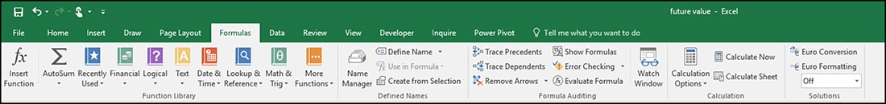
Entering a function in a cell
There are two methods for inserting functions:
  The Insert Function dialog box.
  The category commands provided in the Function Library.
Both avenues get you to the same place - the Function Arguments dialog box. The Function Arguments dialog box enables you to specify the arguments to be used by the function. This can require that you specify a range of cells or individual cell addresses. Because the Function Arguments dialog box provides separate input boxes for the required arguments for the function, you can use the mouse to easily specify the arguments directly on the worksheet. This can greatly cut down on the possibility of specifying the wrong range or cell address in the function.
Although using the Function Arguments dialog box is relatively straightforward, some of the more commonly used functions, such as SUM, AVERAGE, and other statistical functions such as MAX (maximum) and MIN (minimum), can be inserted in a more direct way via the AutoSum command.

Slide 14
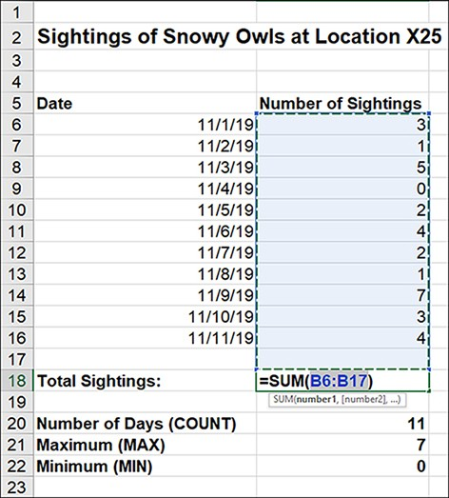
Using AutoSum
You can insert the SUM function into a worksheet using the AutoSum command on the ribbon’s Home tab or the AutoSum command in the Function Library group of the ribbon’s Formulas tab. Select the cell where you want to place the SUM function.
Typically, you choose a cell that is at the bottom of a column of values or at the end of a row of data.
When you select the AutoSum command, AutoSum inserts
=SUM
and selects the range of cells to be included in the function. The range is also speciﬁed in the function.

Slide 15
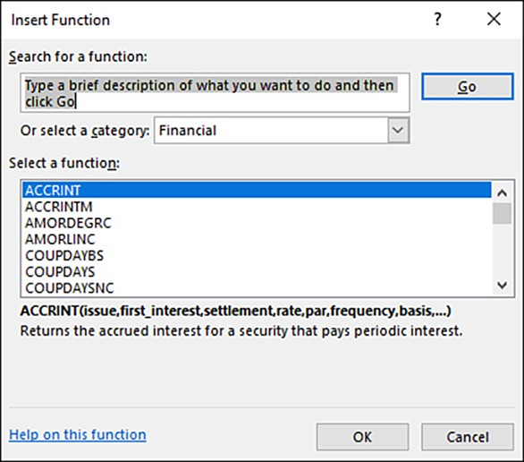
Using the Insert Function dialog box
The Insert Function dialog box can be accessed via the AutoSum drop-down menu; select the AutoSum drop-down arrow on the Home tab of the ribbon and then select More Functions.
You can also access the Insert Function dialog box from the Insert Function command on the ribbon’s Formulas tab. In either case, the Insert Function dialog box opens

Slide 16
Using the Function Library
Another alternative for inserting a function into a sheet is to use the function category commands that are provided in the Function Library group on the ribbon’s Formulas tab. The Function Library group also provides access to the Recently Used command, which lists recently used functions as well as the Insert Function command and the AutoSum command, which has a drop-down menu that includes other statistical functions, such as AVERAGE and MIN.
Each of the Function Library categories provides access to an entire category of functions. The command groups on the Formulas tab are as follows:
  Function Library
  Deﬁned Names
  Formula Auditing
  Calculation

Slide 17
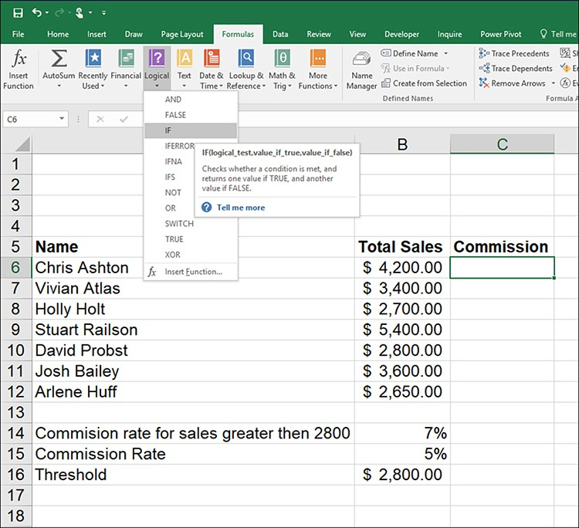
Using the Function Library (cont.)
To take advantage of the Function Library, select a function category to view the functions in that category. Place the mouse on a function (in a category list). A ScreenTip appears that provides you with a brief description of the function.

Slide 18
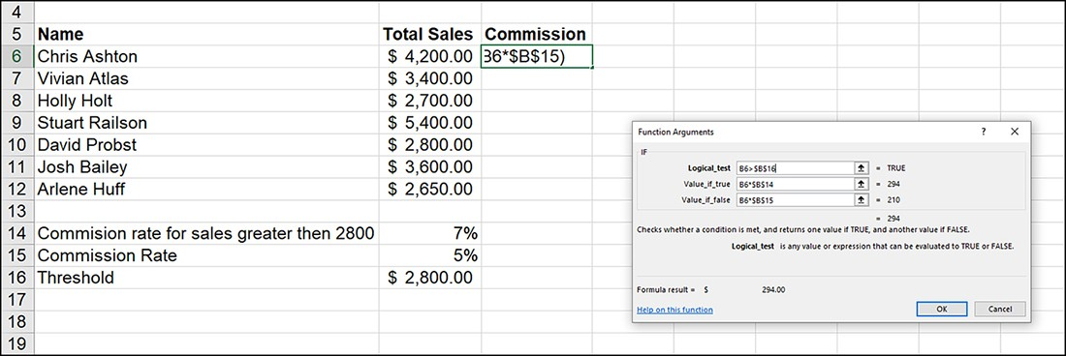
Copying, moving, and deleting cell contents
After you locate the function that you want to insert into the worksheet, select the function in the gallery. The Function Arguments dialog box opens. In Figure, the IF function is shown, which requires that a logical test be provided along with a value if true and a value if false. The logical test can include cell addresses, operators, and a constant, if needed. The value if true can be a calculation, a cell address, or a text string. When you include text strings in functions, you need to place quotation marks around the text.

Slide 19
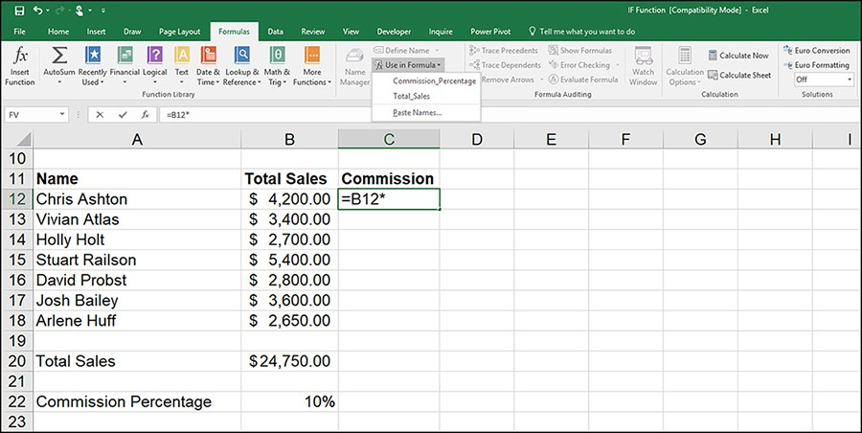
Inserting a range name into a formula
You can insert range names into your formulas as you create them in a cell. Begin the formula by typing the equal sign ( = ); specify any cell addresses to be included in the formula by clicking that cell or selecting the cell range. Add operators as needed to the formula. When you want to specify an argument by range name, select the Use In Formula command and select the range name from the list provided. The Commission Percentage range name, which is the range name for cell F18 (the commission percentage value), is pasted into the formula. If you need to paste additional range names into the formula, repeat the process using the Use In Formula command. Press Enter when you have ﬁnished creating the formula.

Slide 20
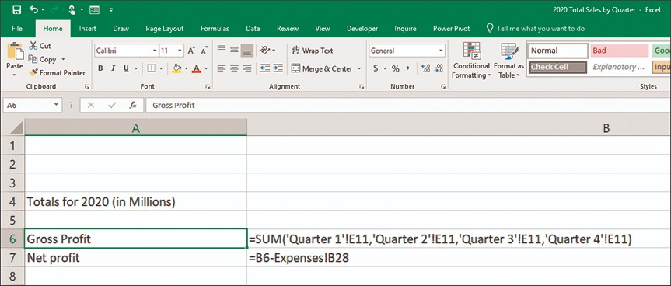
Referencing cells or ranges on other worksheets
When you work in situations where data that spans more than one sheet in an Excel workbook must be summarized, you need to include cell references in a formula or function that consist of cell addresses or ranges that are not on the current worksheet (the worksheet that contains the formula or function). Here is the syntax for a cell reference on a worksheet that is in the same workbook as the sheet you are working on:
'sheet name'! cell address.
Figure shows a function and a formula that reference cell addresses on other worksheets in the workbook. Specifying these addresses using the point-and-click method is much easier than trying to type the cell references into the formula or function.

Slide 21
Choosing the right function
Excel functions provide you with ready-made formulas for just about any type of calculation you want to undertake. Statistical, Financial, and Math & Trig are all examples of function categories that supply functions that perform calculations.
Statistical functions, such as COUNT and AVERAGE, are designed for doing statistical analysis.
Financial functions, such as PMT and FV, compute the monthly payment on a car or house and the return on an investment, respectively.
Math & Trig functions, such as SINE and COS, return the sine and cosine of an angle, respectively.

Slide 22
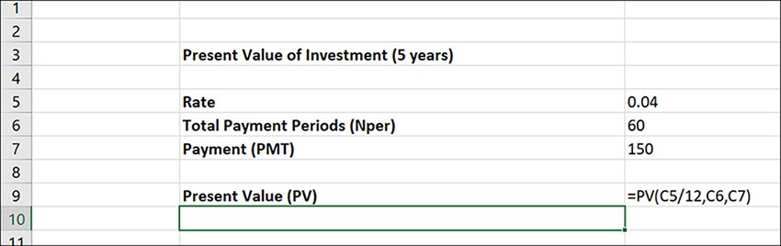
Financial functions
The ﬁnancial functions provide you with the ability to do all sorts of diﬀerent ﬁnancial calculations; there are depreciation functions, ﬁnancial functions (related to securities), and investment and annuity functions. Many of these functions are related to ﬁnancial and accounting principles that require a solid knowledge base to use them correctly. However, there are other simpler ﬁnancial functions that just about anyone can take advantage of. For example, you can easily calculate the monthly payments on loans, compute the present value of an investment, and determine the future value of an investment.
Another piece of information that you need to supply to a ﬁnancial function such as PV is the total number of payment periods in the investment, or Nper; the Nper is based on the number of payments you make annually. So, if you make monthly payments on the investment for ﬁve years, the Nper is 60 (5*12).
The PV function also needs to know how much the payment was each period. For PV to work, the payment must be the same for each period during the life of the investment.

Slide 23
Lookup & reference functions
The Lookup & reference functions provide a number of diﬀerent functions, such as HYPERLINK (enables you to specify a link to a local or remote ﬁle), TRANSPOSE (converts a vertical range to a horizontal range, or vice versa), and the Lookup functions
  VLOOKUP and
  HLOOKUP
VLOOKUP does a vertical lookup and returns a value from an array (which is just another word for a multicolumn lookup table) based on the search criterion. For example, you can create a four-column array that contains employees’ last names in the ﬁrst column, their ﬁrst names in the second column, their departments in the third column, and the phone extension of each employee in the fourth column. It is this fourth column that serves as the information that VLOOKUP inserts into the worksheet.
Place the VLOOKUP function in the Extension column of the sheet (directly to the right of the employee name column); the function then automatically looks up the phone extension based on the information in the employee name column.

Slide 24
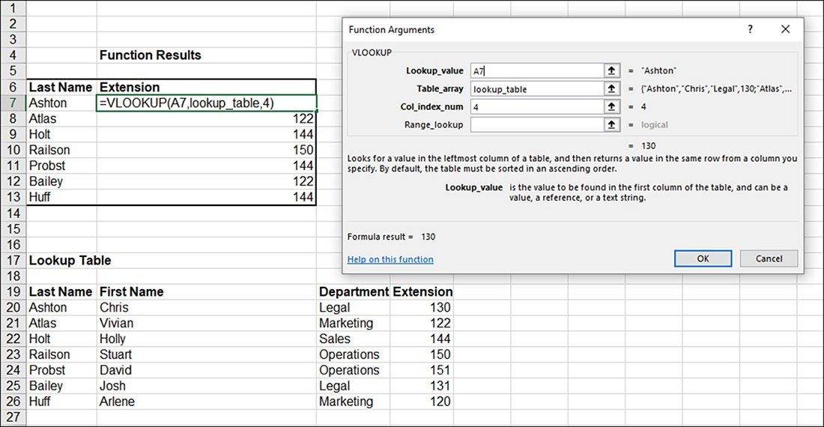
VLOOKUP function
Figure shows a VLOOKUP function that looks up the phone extension for each employee as his or her name is entered in the ﬁrst column of the Function Results table. The Table array is in the range of A20:D26. When you specify the array in the VLOOKUP function, you do not include the column headings. The syntax for VLOOKUP is as follows:
=VLOOKUP(Lookup_value,Table_array,Col_index_num)
The VLOOKUP function can be accessed via the Lookup & Reference command on the ribbon’s Formulas tab. If your information is in rows rather than columns, you can use HLOOKUP, which is set up in a very similar manner to VLOOKUP.
https://www.youtube.com/watch?v=ODZfwD39gGE

Slide 25
Other function categories
Excel also contains other function categories than those we have discussed thus far. When you select the More Functions command, several function categories are listed, such as Statistical, Engineering, and so on.
Math & Trig: This group provides a combination of useful mathematical and trigonometric functions. Functions such as COS (cosine), SIN (sine), and TAN (tangent) are used in computations related to a right-angled triangle.
Engineering: For example, there is CONVERT, which converts measurements from one system to another (such as miles to kilometers). Another conversion function provided in this category is the BIN2HEX function, which can be used to convert binary numbers to hexadecimal.
Cube: The cube functions are used to interact with external data that is derived from an analysis services cube. The data is served up from a Microsoft SQL Server that provides the analysis services.
Information: These functions enable you to derive information concerning a cell, such as the content or formatting of a cell. For example, the ISERR function returns TRUE if an error exists in a cell (meaning an incorrectly designed formula or function) or FALSE if there is no error in a cell. ISBLANK is similar in that it returns either TRUE or FALSE based on whether or not a cell is blank.
Compatibility: This category consists of functions that were native to earlier versions of Excel but have been replaced by new functions in the current version of Excel.

Slide 26
Common error messages
Excel seems to have an endless supply of error messages, and it does have your back when a formula or function contains an egregious error. Excel ﬂags the problem formula or function with a speciﬁc error message.
Error Message | Description
#REF | A cell referenced in the formula or function cannot be found. This can be the result of an incorrect range name or specifying a range that no longer exists.
#NAME? | Excel does not recognize text included in a formula or function such as a range name. This can be a syntax error (an incorrectly spelled function name) or a problem with a range name speciﬁed in the function.
#DIV/0! | The formula or function is attempting to divide by 0. This is typically due to an incorrectly referenced cell in the formula or function (a cell that does not contain a value).
#VALUE | An incorrect argument is present in the formula or function. This can be caused by referring to both text and value entries in the same formula or function.

Slide 27
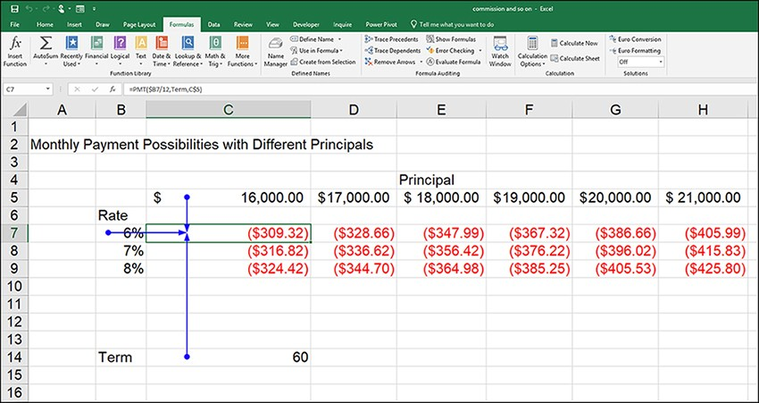
Using the auditing tools
Two extremely useful formula-auditing commands are Trace Precedents and Trace Dependents. To display the cells that are referenced by a particular formula or function - the precedents - select a formula or function in the worksheet and then select the Trace Precedents command. Blue arrows are drawn from the precedents for the currently selected function or formula.

Slide 28
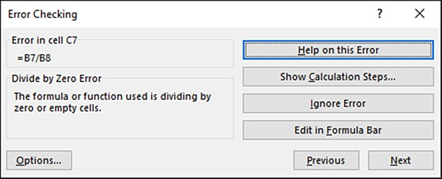
Using data bars
Another useful auditing command is the Error Checking command. It can be used when a cell contains an error message. The Error Checking command (in the Formula Auditing group) opens the Error Checking dialog box. The Error Checking dialog box enables you to access help in the Excel Help window related to the type of error present in the cell. It also enables you to show the calculation steps and evaluate the formula. When you select Show Calculation Steps, the Evaluate Formula dialog box opens. Select Evaluate to begin evaluating the formula or function. You can also step in and out on the diﬀerent portions of the formula or function until you ﬁnd the portion of the formula or function that is causing the error.

Slide 29
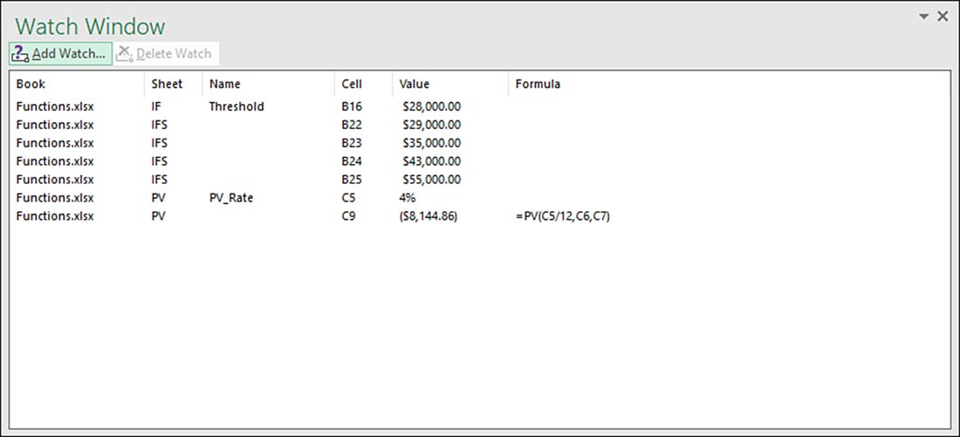
Using the Watch Window
Although it is not an auditing tool per se, the Watch Window can be a useful tool in monitoring certain cells in a worksheet in terms of how the entering of worksheet data or the editing of worksheet data aﬀects those cells. To open the Watch Window, select the Watch Window command in the Formula Auditing group. To add a cell to the Watch Window, navigate to the sheet that contains the cell or a cell range and then select Add Watch in the Watch Window. The Add Watch dialog box opens. Select the cell or cell range, and the reference is added to the Add Watch dialog box. When you click Add and return to the Watch Window, the cell reference is listed.

Slide 30
Useful links
https://support.office.com/en-us/article/video-sort-data-in-a-range-or-table-ffb9fcb0-b9cb-48bf-a15c-8bec9fd3a472
https://support.office.com/en-us/article/video-use-conditional-formatting-03ab07da-1564-4913-b69f-2b1a370c8910
https://support.office.com/en-us/article/video-vlookup-when-and-how-to-use-it-9a86157a-5542-4148-a536-724823014785
MS Excel Tutorial

Slide 31
Thank you for your attention!

